Slide 1
Overview of the Alliance
Joyce Statz
Chair, Austin Firewise Alliance

Slide 2
The Alliance Has Evolved
Created in 2013 by Josh Portie, AFD “Wildfire Guy”
Initially, helped plan the annual Wildfire Prevention Symposium in May
Gradually became a mutual support forum for neighborhoods
Current approach
Neighborhood leaders and AFD Wildfire Division meet quarterly to discuss wildfire issues and solutions
Offer quarterly in-depth training on being Firewise
Act as a sounding board for AFD Wildfire Division
Advocate with City Council and City staff for wildfire prevention

Slide 3
Alliance Members Today
29 neighborhoods – about half of them Firewise Communities
7 participants from AFD Wildfire Division
1 participant – Texas Forest Service

Slide 4
Our Firewise Communities are Varied
Small ones with as few as 5 homes
Large ones with as many as 900 homes
Experienced ones – Meadow Mountain with more than 10 years as a Firewise Community
Newest – Greater Valburn Circle, recognized in 2018

Slide 5
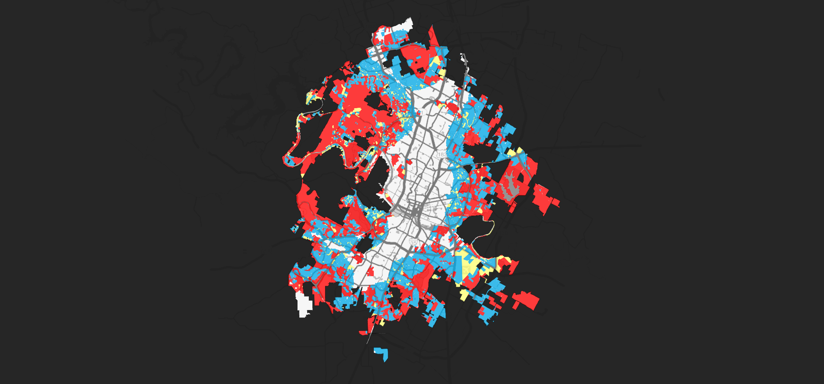
COA Footprint in Risk Levels
WUI Code
footprint & classes
Not
WUI
Not WUI
Fuel Modelᵇ | Proximity to Contiguous (40 Acres) Wildland Fuels
 | 150’ to 1.5 miles |  |  | < 150'
 | Slope (%)
 | < 10 | 10 to 25 | > 25 | < 10 | 10 to 25 | 25
Light | M | M | M | M | M | H
Medium | M | M | H | E | E | E
Heavy | H | H | H | E | E | E

Slide 6
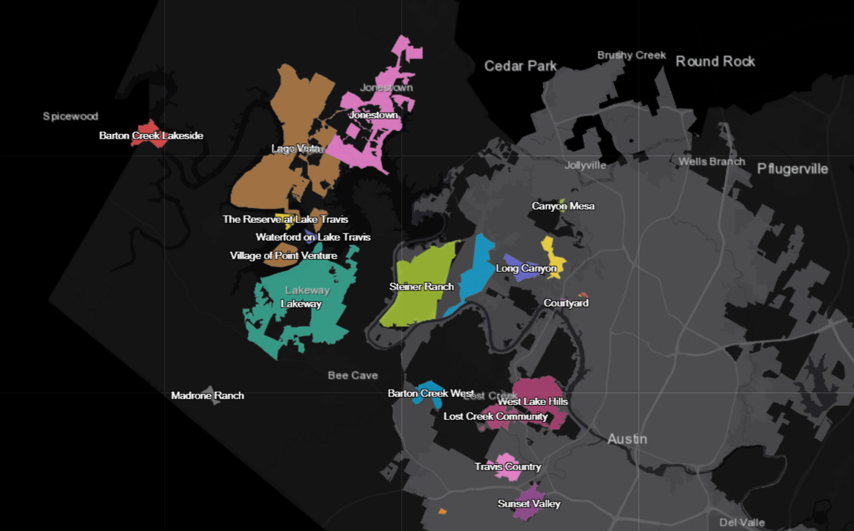
Where are the Austin/Travis County Firewise Communities?
Community Wildfire Preparedness
Firewise and CWPPs
Valburn Circle

Slide 7
Our Request to You
If your neighborhood is in the red, blue, or yellow of the risk levels, and you are not in the Alliance
You need to be taking action
Joining the Alliance gets you partners with advice
Getting involved gets you training and knowledge
Email: joyce.statz@gmail.com to get started

