Slide 1
An Intro to Racial Equity

Slide 2
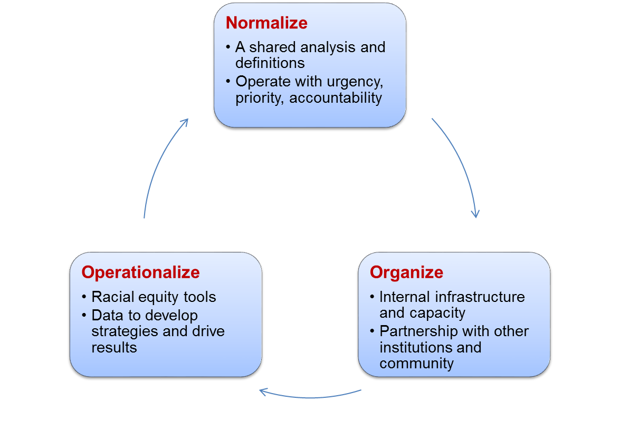
Who we are:
Equity Lens

Slide 3
Our values vs. our realities

Slide 4
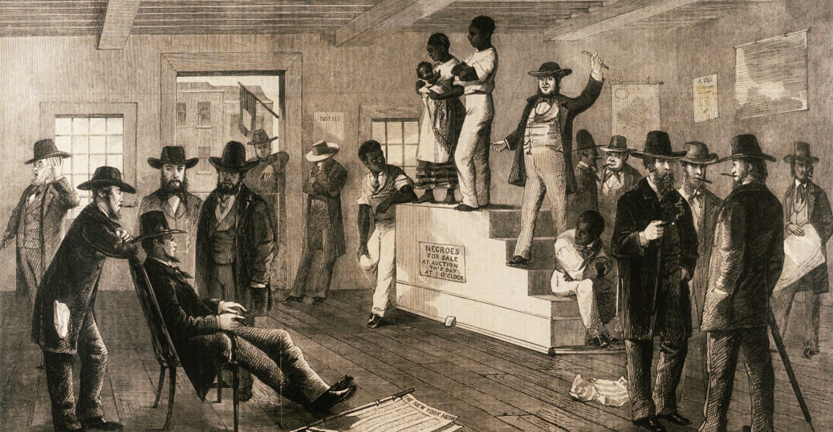
All men are created equal...
...was revolutionary at the time, but when Jefferson spoke these words, they applied to White male property owners.
Notes:
Photo source:
https://www.google.com/search?q=historical+illustration+of+enslavement&source=lnms&tbm=isch&sa=X&ved=0ahUKEwitvM-rrbfZAhXLTd8KHYaMBMYQ_AUICigB&biw=1362&bih=623#imgrc=DcUlwxh8hBy1ZM:

Slide 5
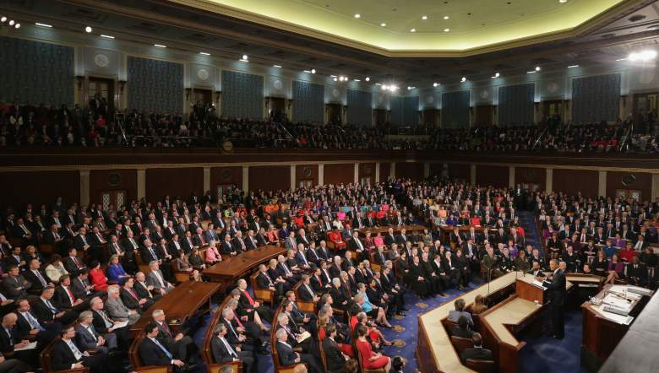
Of the people, by the people, and for the people...
...yet our leaders across all industries don’t come close to the diversity of our communities. Women didn’t get the right to vote until 1920. Until the Voting Rights Act of 1965 People of Color were guaranteed access to their vote
Notes:
Photo: https://heavy.com/news/2017/05/which-house-republicans-vulnerable-face-reelection-2018-election-voted-for-donald-trump-hillary-clinton/
VED: Add ‘reflective’

Slide 6
Your
Values:

Slide 7
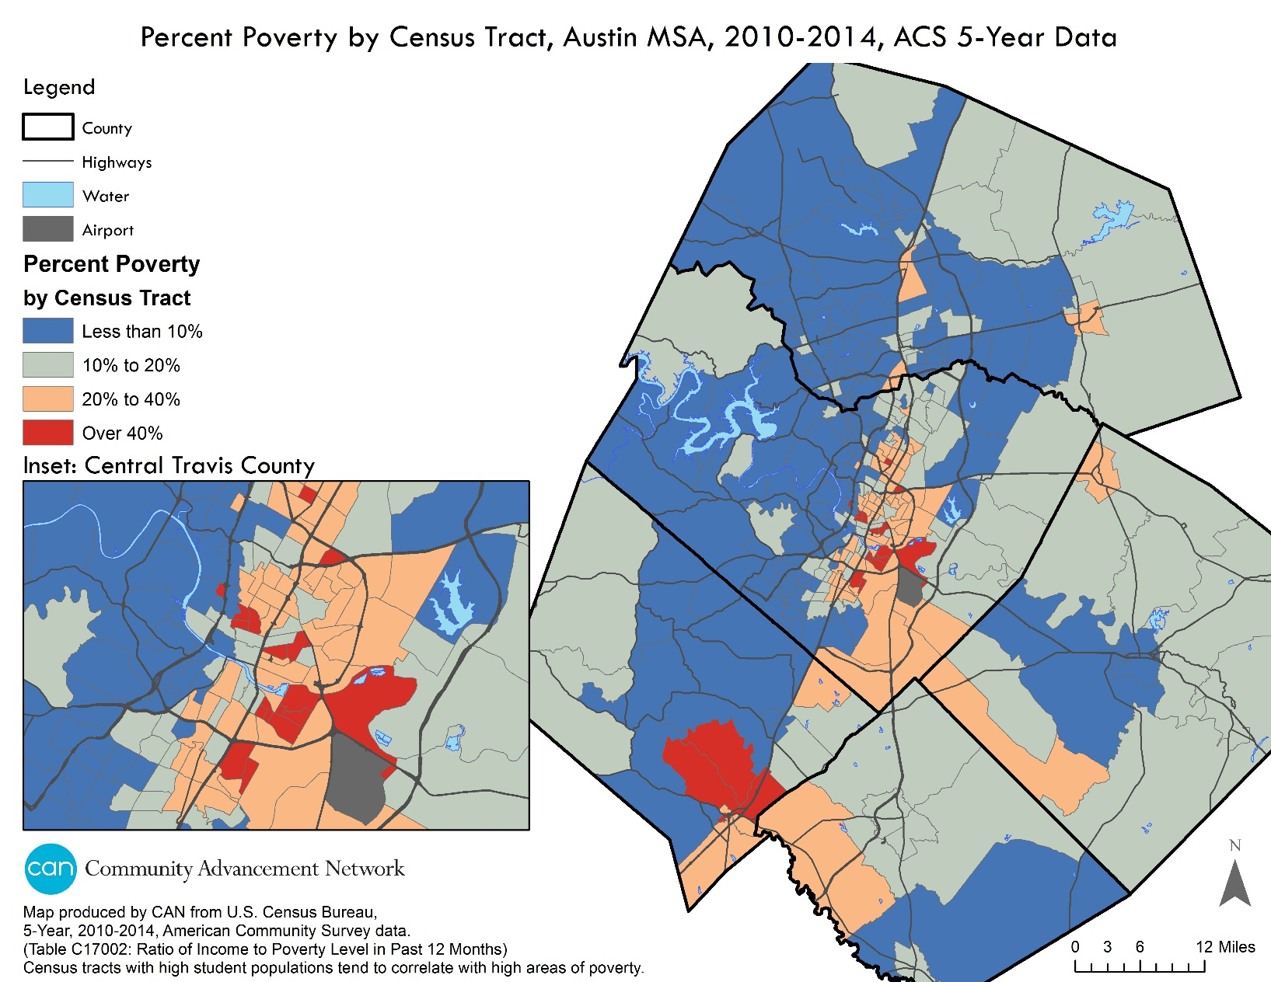
...yet

Slide 8
Who lives in these neighborhoods?
51% of Black Americans and 44% LatinX live in high-poverty areas, vs. just 17% of White Americans

Slide 9
How does this impact people?
Brookings reports people living in concentrated poverty face:
higher crime rates
poorer physical health
low-performing schools
higher dropout rates
poor job-seeking networks

Slide 10
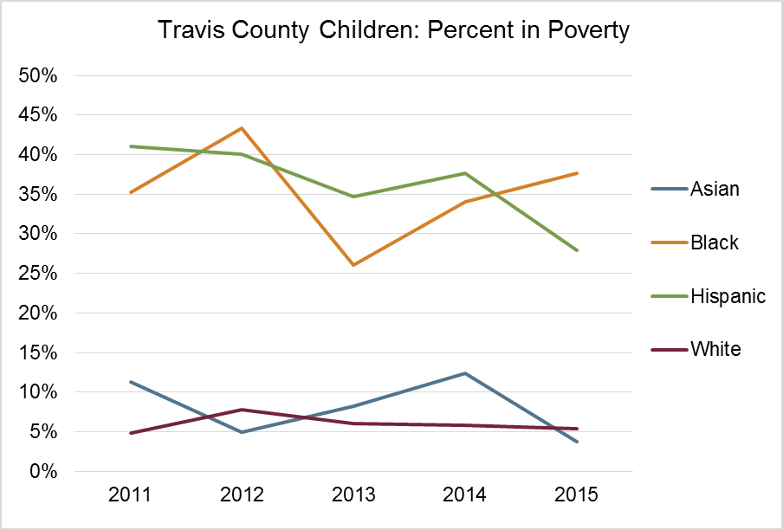
Child poverty disparities, Travis County
Hispanic and Black children are 5 to 7 times more likely to live in poverty than White or Asian children.
Source: American Community Survey, 1-Year data, 2015

Slide 11
Who can’t afford housing?
source: PolicyLink National Equity Atlas

Slide 12
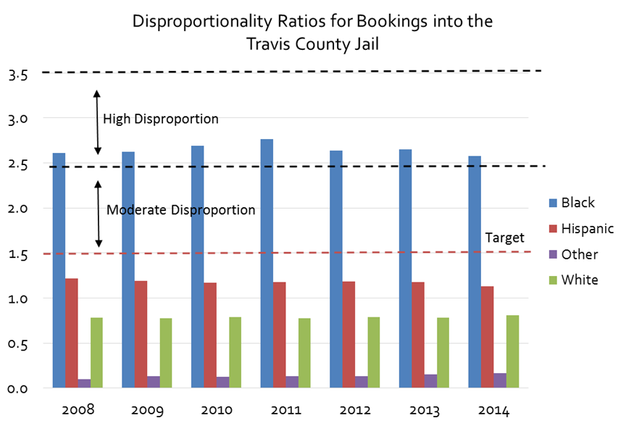
Criminal Justice
Having a criminal history impacts your ability to…
get a job
rent a home
move back with your family
get a loan
pursue certain professions

Slide 13
Homelessness

Slide 14
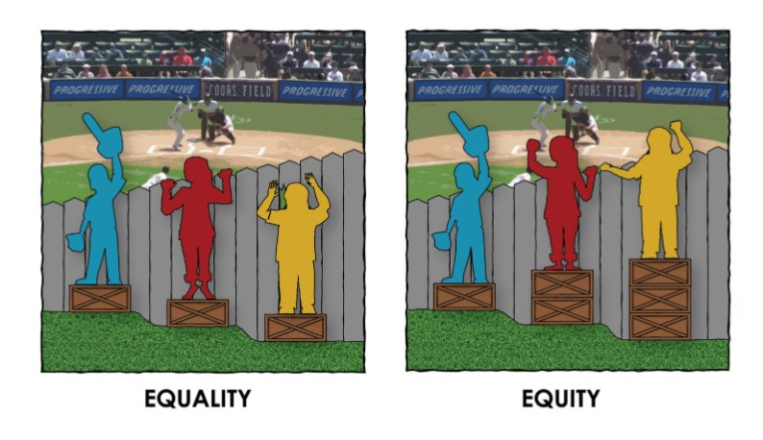
RACIAL EQUITY MEANS...
COA Equity Statement
Racial equity is the condition when race no longer predicts a person’s quality of life outcomes in our community.
The City recognizes that race is the primary determinant of social equity and therefore we begin the journey toward social equity with this definition.
The City of Austin recognizes historical and structural disparities and a need for alleviation of these wrongs by critically transforming its institutions and creating a culture of equity.

Slide 15
What do you know about the racial history of Austin?

Slide 16
Acknowledging how we got here
Inheriting inequality
“As greater Austin booms, the poisonous legacy of segregation continues to cut off the African-American population from economic opportunities and its own cultural anchors, threatening the whole region's potential.”
-An American-Statesman three-part series
http://projects.statesman.com/news/economic-mobility/
Notes:
In 1928, a master plan legally designated East Austin as a “Negro District”. As de jure segregation was illegal in Texas, planners used zoning and "separate but equal" legislation. They also simply removed African American services—schools, parks, and libraries—from neighborhoods designated as "white." Measures implemented to enforce and reinforce geographic segregation included real estate deed restrictions and city ordinances that prohibited African Americans and Mexican Americans from buying or renting homes anywhere in Austin outside of East Austin, as well as denying access to city utilities to African American homes outside this neighborhood. Churches and schools originally serving the African American and Mexican American communities in west central were literally moved (brick by brick) to East Austin. Zoning ordinances approved along with the plan permit industrial uses directly adjacent to residential areas. The western boundary of the segregated area is East Avenue, which later becomes I-35 as it slices through Austin.

Slide 17
Visual Thinking Strategies: Seeing the Unseen

Slide 18
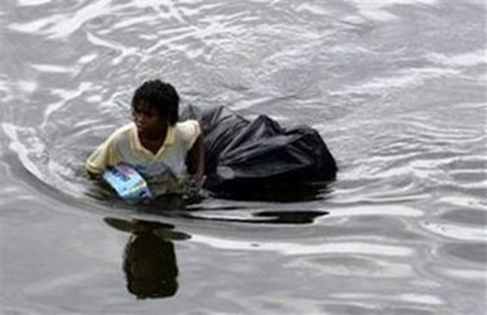
What do you see?

Slide 19
What do you see?

Slide 20
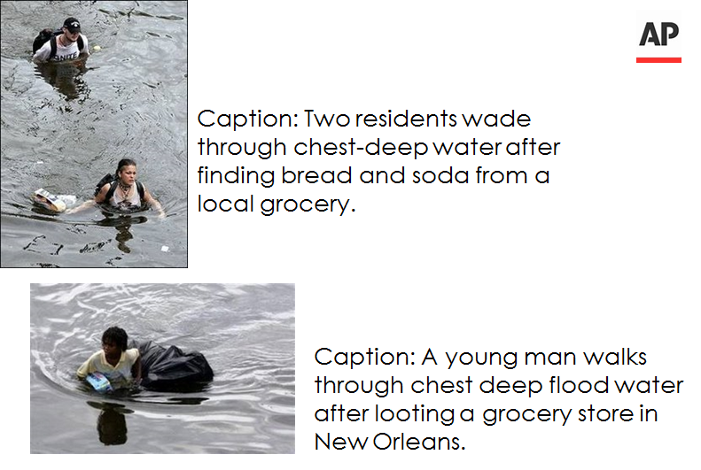
What the AP saw:

Slide 21
Takeaways...
“…implicit bias is a natural, unavoidable part of our brain function; however, through acknowledgement and understanding of its presence, implicit bias can be distinguished from prejudice. Implicit bias, itself, is not static. The attitudes and stereotypes we have learned through media and learned experiences are social in nature and likely to evolve. Implicit bias is experienced on an individual basis, but also influences society on an institutional basis. Daring to engage in that social experiment is key and willingness to address systemic inequities could lead to a very different, truly inclusive world.”
-Haas Institute Director, john powell

Slide 22
LEARN, ACT, PARTNER
Consider overlaying an equity lens to your initiatives:
1. Know the History: Consider historical context of projects. Does the project address events that have negatively impacted communities of color? Acknowledge them and create space for communities to share as to not repeat the same mistakes.
2. Review & Monitor the Data: What are the data and projected impact of the project? What do the data tell us? Are they disaggregated by race/ethnicity?
3. Engage the Community: How have communities been engaged? Are there opportunities to expand engagement and what were the efforts to reach most marginalized populations and bring those voices into consideration?
4. Advance Racial Equity: Does this project have an opportunity to advance equity within Council Six Outcome Priorities and reduce/eliminate a disparity?
5. Analyze Unintended Consequences: Are there any possible unintended outcomes for this project? Could the project have a negative impact on communities of color and/or other marginalized populations?

