Slide 1
Small Area Planning Joint Committee: The Future of Planning
Jolene Kiolbassa and David King, SAPJC members appointed by the Zoning and Platting Commission, presentation to the Austin Neighborhoods Council

Slide 2
SAPJC
Comprised of three ZAP members and four PC members
Also oversees Waterfront Overlay
Meetings held on 1st & 2nd Wednesday of every other month at 11:30 am
Not recorded, no meeting audiotape or videotape exists of past meetings

Slide 3
Questions in Wake of CodeNEXT
Volunteer fatigue
How can stakeholders trust the city’s planning process?
Why should anyone participate after their efforts in NPs and Vertical Mixed Use (VMU) are being disregarded?
Need data first:
reliable, accurate zoning capacity analysis of the entire city before any more plans are completed
Infrastructure inventory with costs required to repair current problems as well as accommodate growth
Water supply inventory
Better mapping, including job centers and undeveloped land
Will Zucker Report finally be taken seriously?
Should we increase entitlements in exchange for affordable housing?

Slide 4
Critique of Corridor Plans
City of Austin 2006 audit criticized fragmented approach to planning, citing NPs, so move should be towards larger plan areas
Many corridors already planned
VMU process already evaluated and applied to corridors
Upzones properties twice (and with VMU, 3x) in a short period of time
Ignores Neighborhood Plans
Countless hours of input already received from thousands of stakeholders
Wasting millions of dollars already spent on NPs*
Why plan areas twice when most of Austin does not have plans?

Slide 5
More Criticism of Corridor Plans
Assumes corridors are divorced from adjacent neighborhoods
Almost anyone can be a stakeholder, so person driving on street can have same impact as resident around the corner
No progress on Neighborhood Side Design Standards to prevent unsightly and unneighborly “back” sides
As if mobility bond money determines which corridors are upzoned, otherwise no process for selecting corridors
At last SAPJC meeting, staff said density needed to qualify for USDOT FTA New Starts program

Slide 6
*Cost of Neighborhood Plans
In one year, 2008,
almost $2 million
Cannot tell how much has been spent on NPs because budget accounting changed.
NPs were once own line item but now are part of Long Range Planning

Slide 7
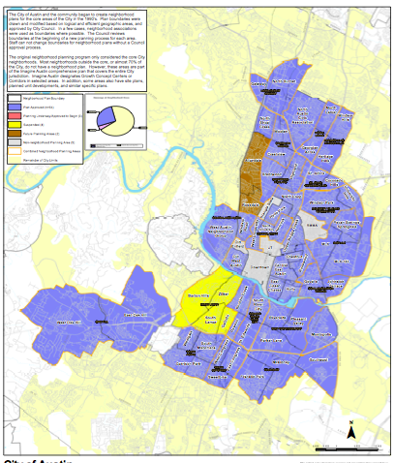
Blue areas show 31 NPs
Beige shows unplanned areas
73% of city geographic area not planned

Slide 8
Unplanned Areas
Experiencing rapid growth
ZAP approving hundreds of housing units every meeting
Yet little attention is paid to amenities
Residents ask for help with infrastructure such as sidewalks
Huge job growth, such as Apple
More likely to be greenfield than closer in, so more likely to be working with a blank slate

Slide 9
Austin’s planning needs to follow the City Charter
Includes “prevent overcrowding of land.” Complete set of criteria includes
improve the public health, natural resources and infrastructure.

Slide 10
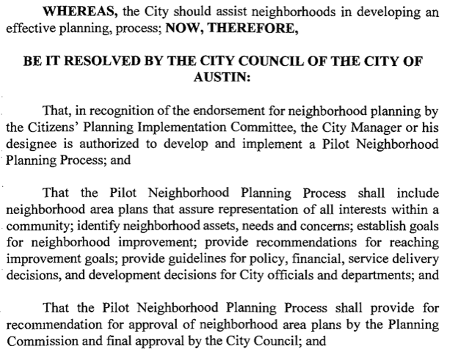
Council on May 21, 1997, started the Neighborhood Plan program

Slide 11
Most NPs Completed in 2000s

Slide 12
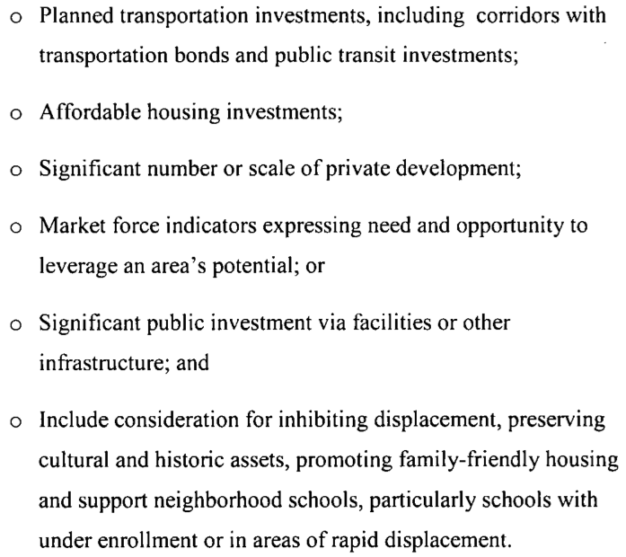
Council Resolution on Corridor Plans
Does not state that NPs will be replaced
Does not eliminate NP process
Assumes CodeNEXT in place
Criteria listed at left

Slide 13
Comparison of Council Resolutions
1997
City will assist neighborhoods
Includes focus on improvements and services
2017
No mention of stakeholders
Criteria includes
market forces
mobility bond investments
private development

Slide 14
Staff’s Performance Evaluation
Performance evaluation is based on processing zoning applications and NPA
Is this appropriate for planning?
Criteria does not include upholding current NPs or current zoning – should it? Should providing predictability to zoning be a criteria?
Acres upzoned was a metric 10 years ago

Slide 15
East Riverside Upzoned Twice
2010/2013 Corridor Plan
2006 Neighborhood Plan

Slide 16
East Riverside Lessons
Upzoned twice with no benefits to existing residents
Increasing entitlements does not bring affordable housing
Residents of market rate affordable Ballpark Apartments will be displaced by luxury condos
No tracking mechanism to measure displacement

Slide 17
Bottom Line on Planning in Austin
Staff is caught in a bind
Not given enough resources
Council directives contradictory and ignore previous millions of dollars spent
Need better zoning and mapping tools, like Zonar
Need holistic approach
Don’t throw out what’s already been done and paid for
Need to align staff performance evaluations with NPs
Requires more data
Then need to work on unplanned areas

