Slide 1
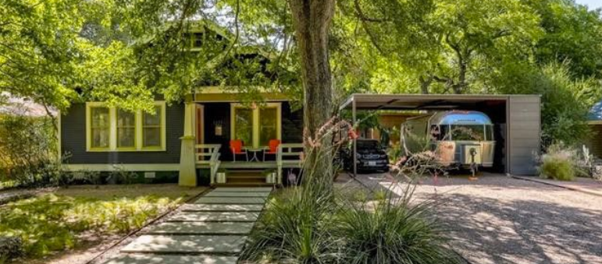
Residential Review at the City of Austin
Susan Barr Austin Neighborhood Council - May 22, 2019
Building a Better Austin Together

Slide 2
TOPICS
Overview
Zoning
Technical Review
Helpful Tips
Permit History Search
Building a Better Austin Together

Slide 3
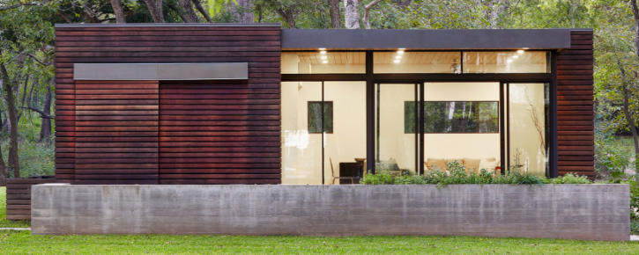
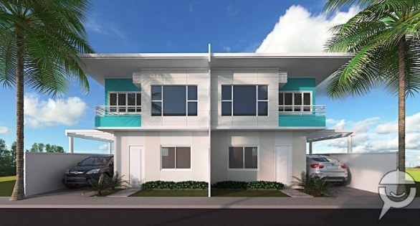
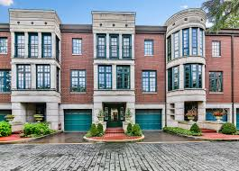
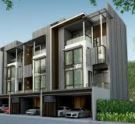
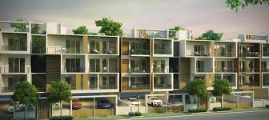
OVERVIEW
We permit residential building types that fall under the International Residential Code (IRC) and their accessory structures.
One and two family dwelling units no more than (3) stories above grade
Townhouses that are no more than (3) stories above grade and don’t have overlapping units
Pools
Garages & carports
Building a Better Austin Together

Slide 4
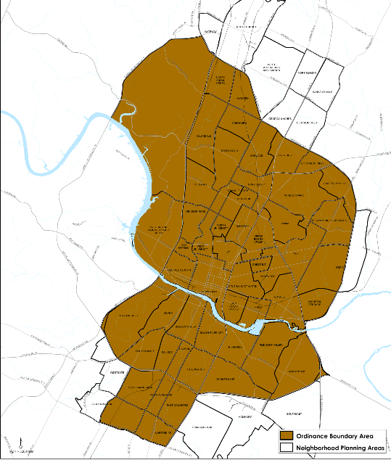
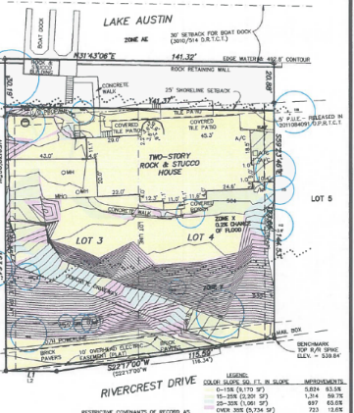
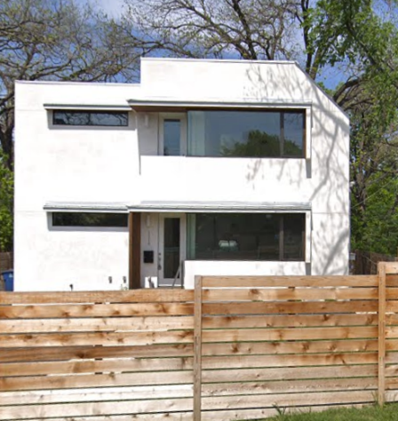
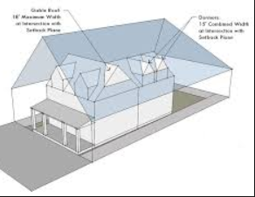
Zoning Review
Zoning
Common classifications
LA
RR
DR
SF-1, SF-2, SF-3, SF-4A, SF-5, SF-6
MF
(+/- 60) neighborhood plans
(6) NCCD’s
Conditional Overlays
Subchapter F
PUDs
Driveway & Sidewalk
Parking
Use
Single family
Secondary apartments
Two family
Accessory Uses
Building a Better Austin Together

Slide 5
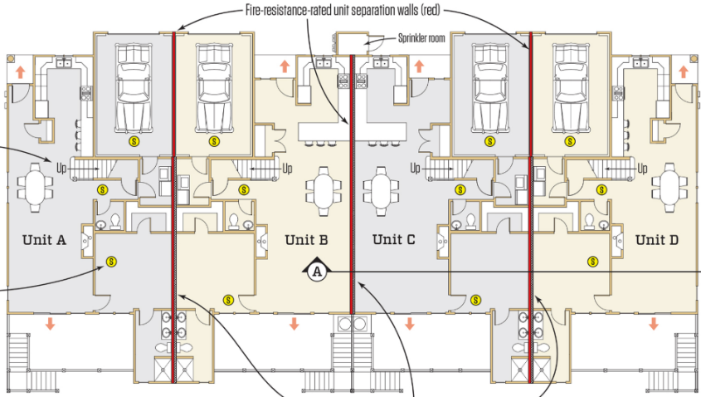
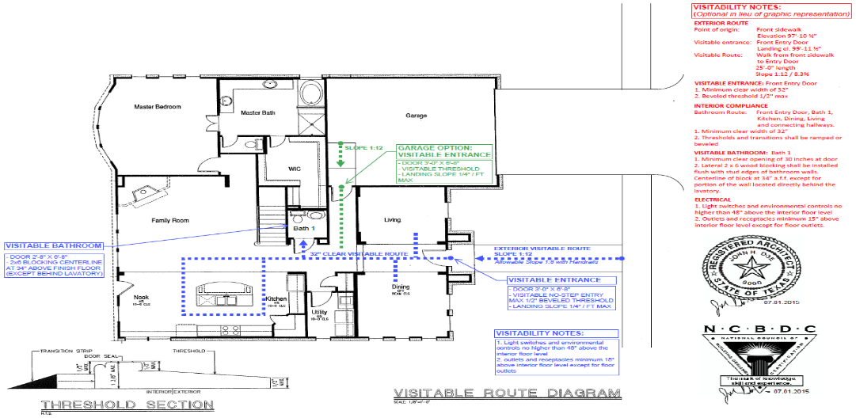
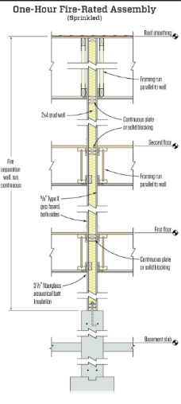
Technical Review
International Residential Code - Chapters 1-3, 5, 6, 8
Fire Resistance Rated Conastruction
Visitability Ordinance
Building a Better Austin Together

Slide 6
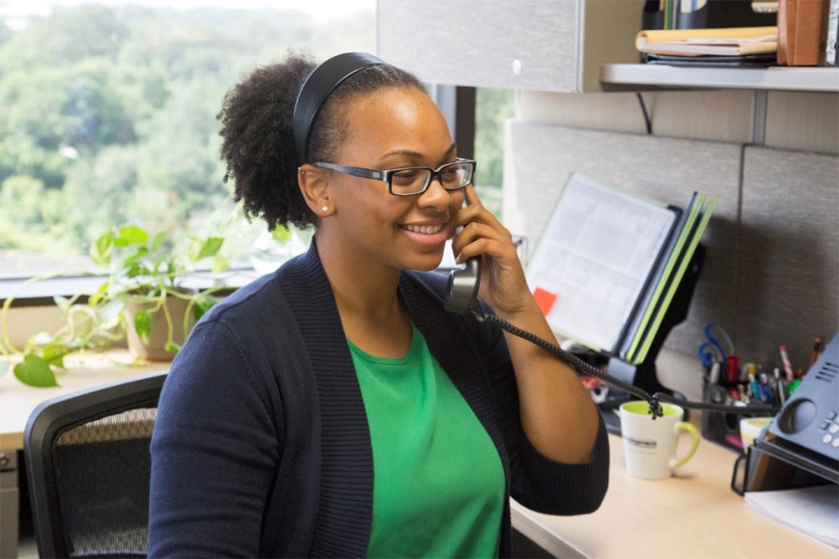
HELPFUL TIPS
Community Outreach
Frost Bank
ABoR
HBA
AIA
NARI
Austin Infill Builders
Tiny Home & Simple Living Jamboree
Home & Garden Show
Atlas 14
Build Expo
Quarterly Stakeholder meetings
Residential Walk-in hours
M, W & F: 8 am – 12 pm
2nd floor of 505 Barton Springs Rd
Online Resources
http://www.austintexas.gov/residentialreview
5. Permttingatx.com
Building a Better Austin Together

Slide 7
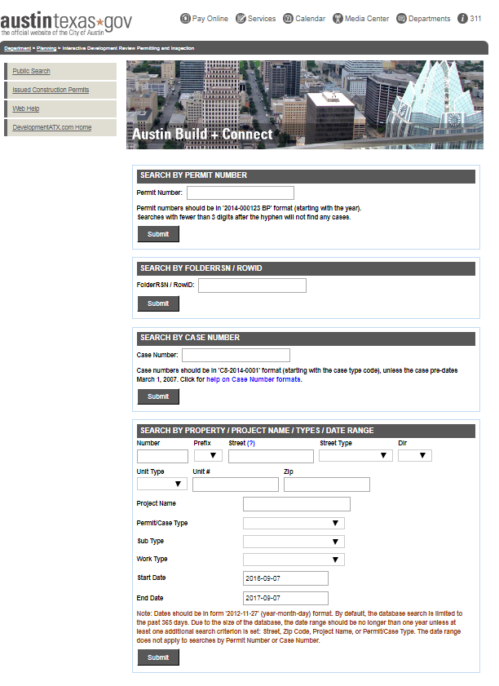
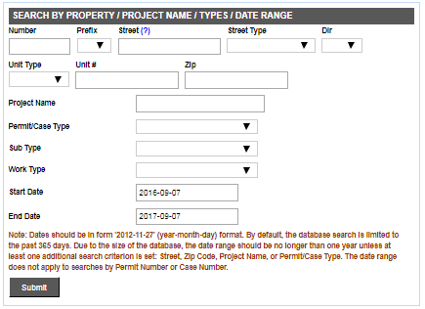
Permit History Search
https://abc.austintexas.gov/web/permit/public-search-other
BACK DATE TO 1980
Building a Better Austin Together

Slide 8
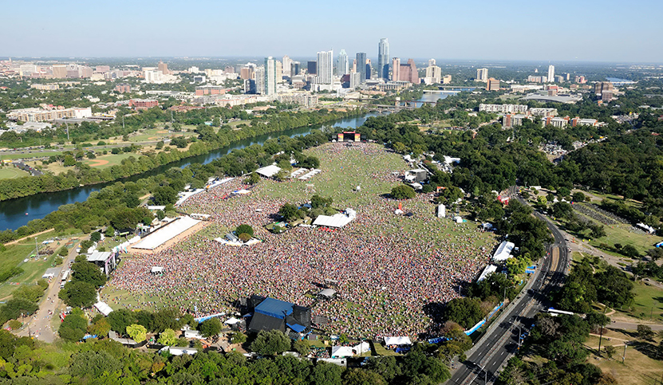
THANK YOU

Slide 9
AUSTIN CODE PRESENTATION | PRESENTED BY JOSE ROIG May 22, 2019

Slide 10
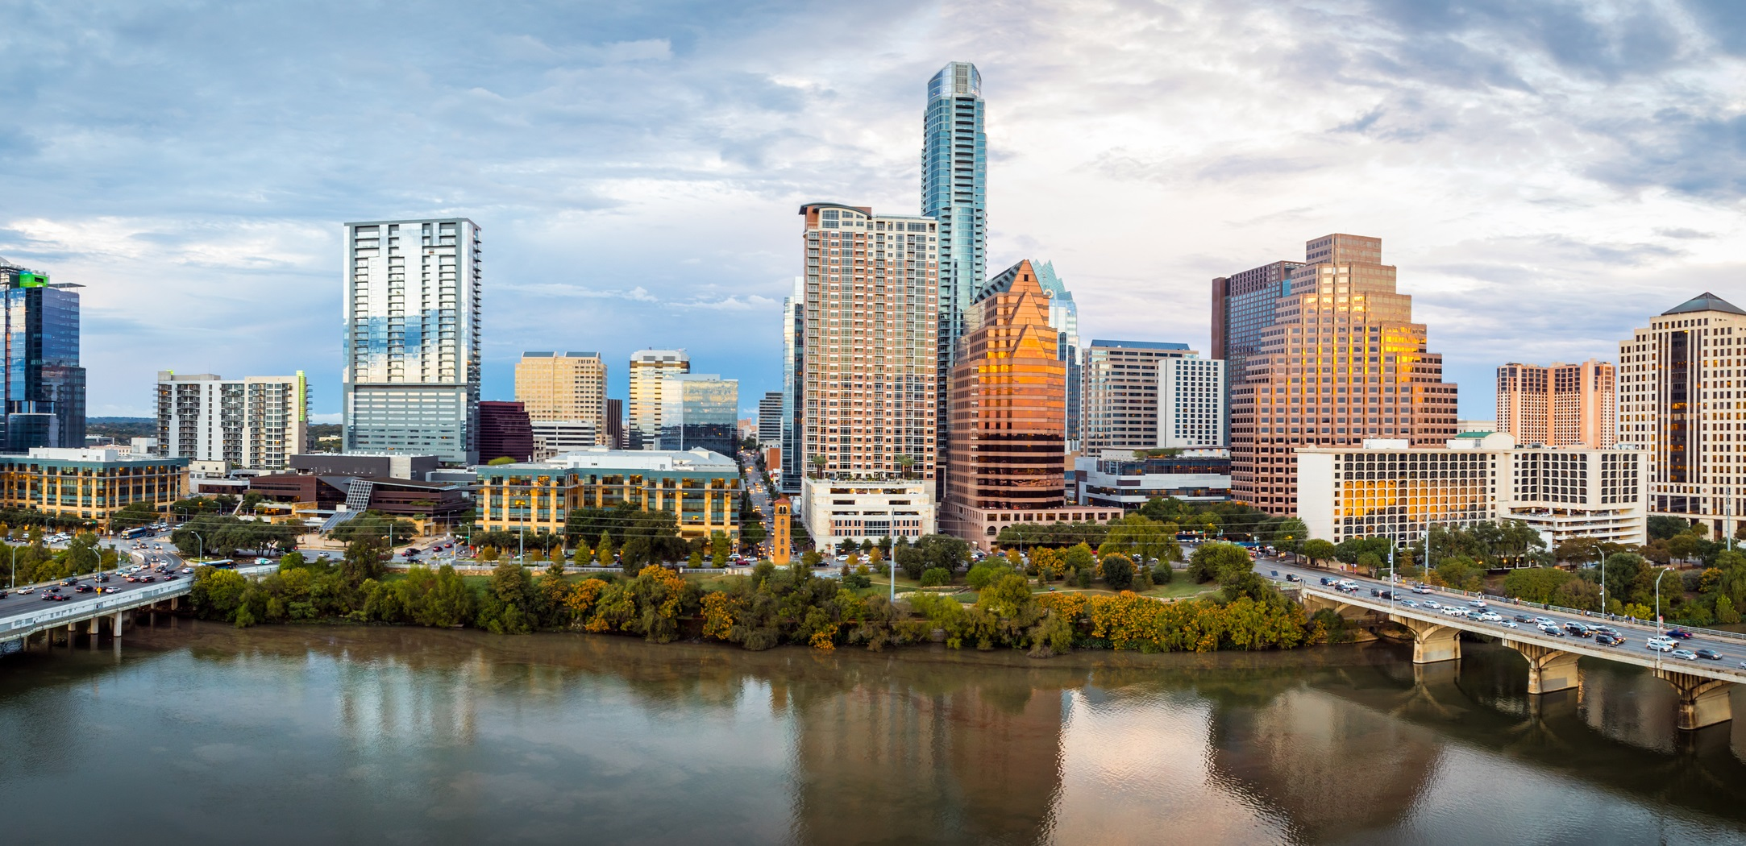
Vision
Building a Greater Austin together through Code Education, Collaboration and Enforcement.

Slide 11
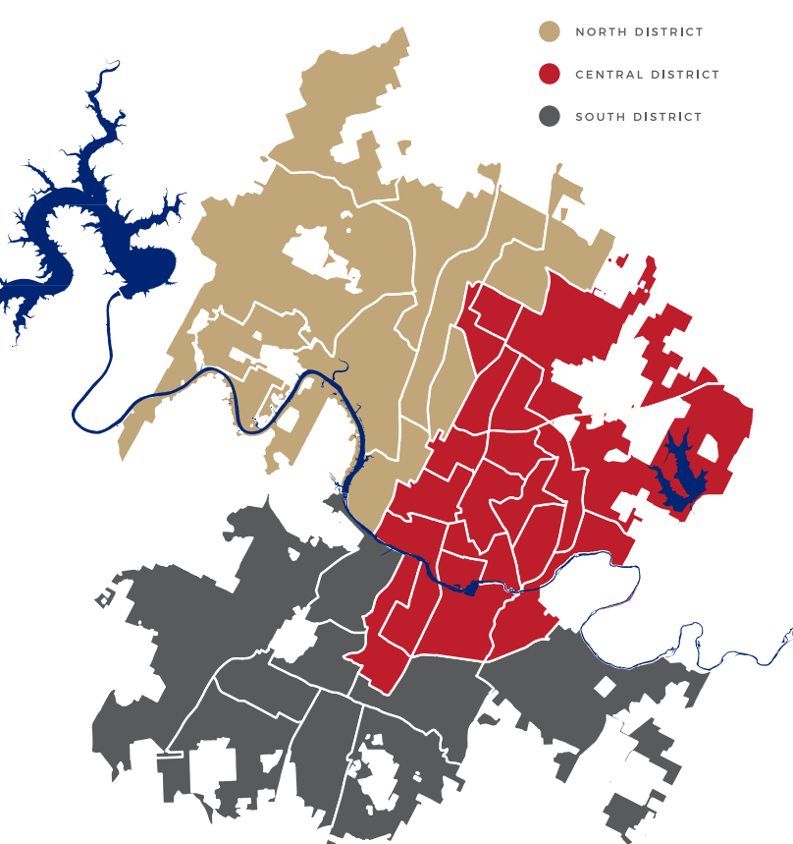
Service Areas
Building a Greater Austin together through Code Education, Collaboration and Enforcement.

Slide 12
WHAT WE DO KEEP PEOPLE SAFE IN OUR HOME, WORK AND COMMUNITY

Slide 13
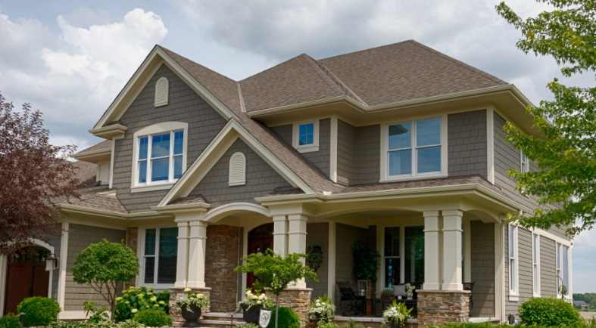
SAFE AT HOME Transforming a city begins at home -- whether it's a house or an apartment.
Austin Code investigates homes, apartments, duplexes and everything in between.
Goal is to bring properties to a safe standard.
Residents can call 3-1-1 to report a safety concern.

Slide 14
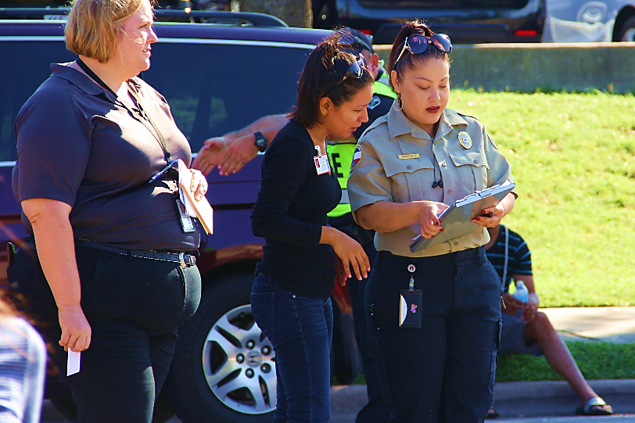
SAFE AT WORK Everyday, thousands of Austin residents enter their workplace building expecting their surroundings and the structure to be safe
Ensure proper zoning of land use.
The licensing and registration program regulates: private waste haulers, billboards, hotels, motels, rooming and boarding houses, mobile homes, short-term rentals, sororities and fraternities and the repeat offender program in our community.

Slide 15
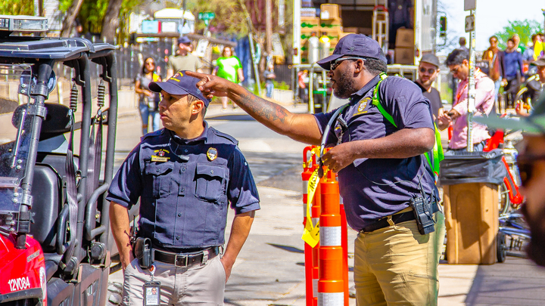
SAFE COMMUNITY Communities are the heart and soul of Austin
Austin Code Department is making sure our surroundings are safe.
Austin Code inspects businesses and city-owned properties in our community.

Slide 16
TOP 5 HOME VIOLATIONS
High Grass and Weeds
Work Without Permit
Trash and Debris
Unsanitary Conditions
Substandard and Dangerous Structures

Slide 17
HOW WE WORK KEEP PEOPLE SAFE IN OUR HOME, WORK AND COMMUNITY

Slide 18
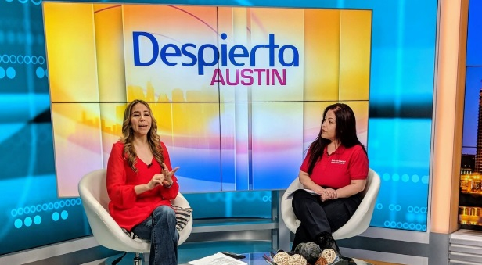
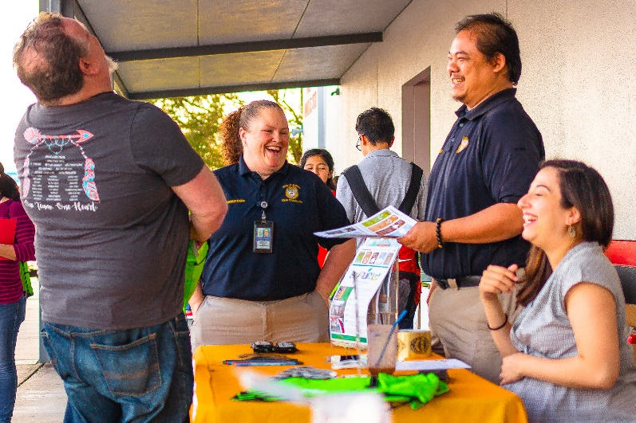
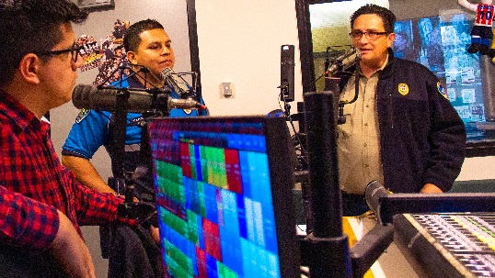
FIRST, EDUCATION Proactive Educational Efforts
Multifaceted quarterly campaigns to the public
Virtual reality tool
Code Connect phone line
Social media
Tabling and speaking events
Inspectors day-to-day

Slide 19
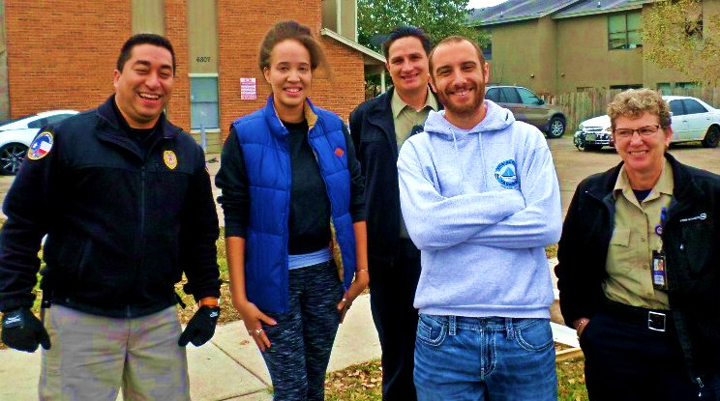
COLLABORATION Network of collaborative culture
Neighborhood and stakeholder meetings
Public Assembly of Code Enforcement (PACE)

Slide 20
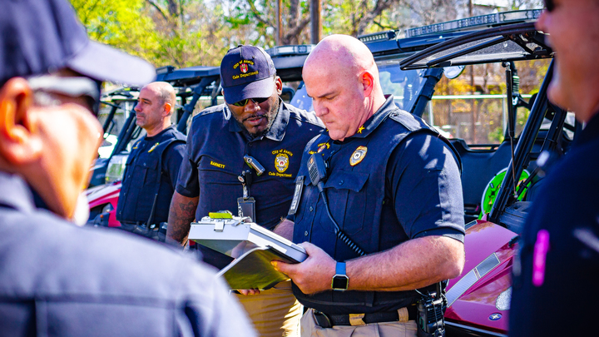
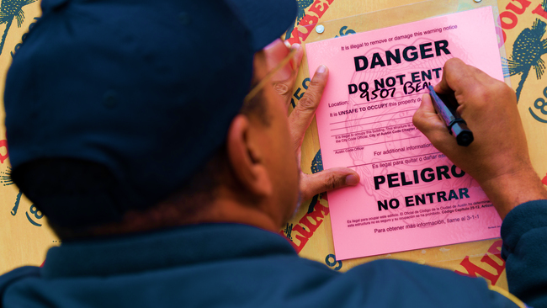
ENFORCEMENT Upholding building, city and property codes
Case Investigations Unit
Licensing and Registrations Unit
Extended Hours

Slide 21
How to report a code violation?
Contact Austin 3-1-1
Online
App
Call

Slide 22
CONNECT WITH US
Request a code inspector
Website: austintexas.gov/code
Social media
Austin 3-1-1 (online, app, or call)
Code Connect, 512-974-CODE (2633)
AUSTINCODEATX
AUSTIN_CODE
AUSTINCODE
AUSTINCODE

Slide 23
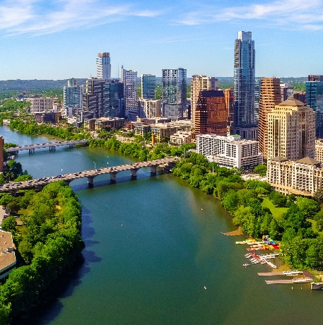
THANK YOU
Any questions?

